Slide 1


Slide 2
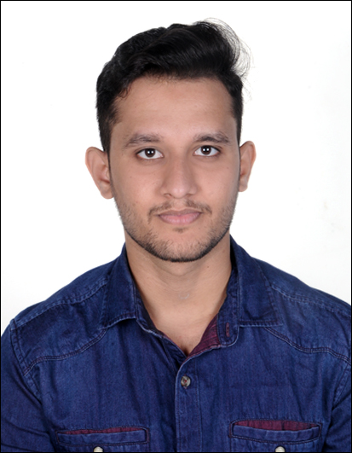
Project Highlights
Project Name : Hospital Management System using C++
Team Size : 1
BU Mentor Name : Mr. Adler Mentor PS# 20035779
Team Members Details (Professional Stamp Size Photo with few lines of individual briefing
MANEESH S DANI
99002519
2009BLRMED01
B.Tech ECE

Slide 3
Project Video Snippet
GitHub Link : https://github.com/99002519/Miniproject_Cpp/tree/main/VideoSummary

Slide 4
Future development that can be implemented further
Hospital Management System project consists of keeping record of the patients and their billing history as per the date instead of writing in the notebook.
This particular mini project can be enhanced to make it a real time application from where the patient can be monitored remotely by either doctor or nurse using cloud data.
This can improved by using machine learning concepts like analyzing heart beat.

Slide 5
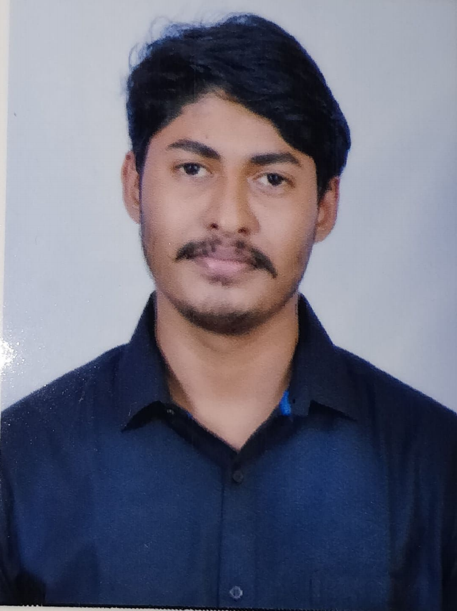
Project Highlights
Project Name : Smartphone Analysis Python Project
Team Size : 2
BU Mentor Name : Mr. Adler, Mr. Arangarajan Mentor PS# 20035779, 20075787
Team Members Details
MANEESH S DANI
99002519
2009BLRMED01
B.Tech ECE
NIRANJANKUMAR M
99002516
2009BLRMED01
B.Tech ECE

Slide 6
Project Video Snippet
GitHub link video link -
https://github.com/99002519/python-project/tree/main/VideoSummary

Slide 7
Future development that can be implemented further
In Smartphone Analysis, we currently compare smartphones by the name which we have in the csv files.
We can further implement for the categories of mobile phones stored in the csv files making it easier for the users to compare any smartphones they want.
We can also implement comparison of full specifications as we have taken some of the major specifications.

Slide 8

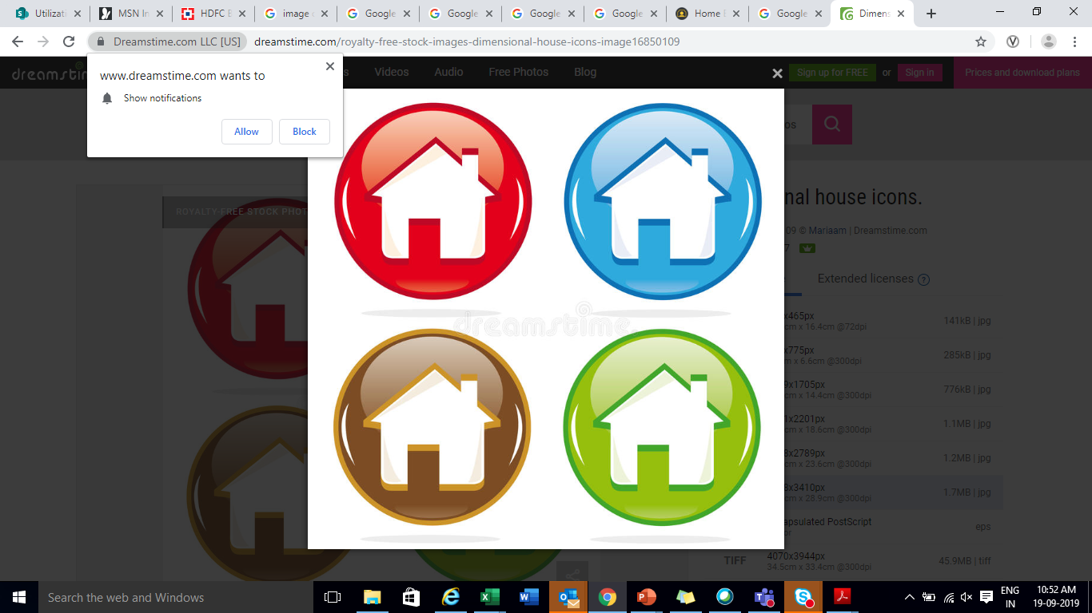
Thank You !

